Slide 1
HireAC
YOUR HOW TO GUIDE

Slide 2
HireAC Guide Sections
Getting Started with HireAC
Cooperative Education Module in HireAC
Changing Preferred Name in HireAC
Downloading the Co-op Work Permit Confirmation Letter
Co-op Documents Page in HireAC
Co-op Job Postings Page in HireAC
Setting up Job Alerts in HireAC
Co-op Interviews Page in HireAC
Co-op Job Offers in HireAC
Co-op Work-term record in HireAC
Booking a Peer Review meeting in HireAC
Events And Workshops Module in HireAC
Career & Employment Module in HireAC

Slide 3
8. Co-op Interviews Page in HireAC
How to review and respond to interview invitations in HireAC

Slide 4
Viewing and responding to interview invitations in HireAC
Co-op interviews may be scheduled by the employers through or outside of HireAC.
When you receive an interview invite through HireAC, you will also receive an email to your Algonquin Live account informing you of your upcoming interview.
You will be directed to log into HireAC to accept the invite and select your time slot.
You are required to respond to all job interviews requests within 24 hours.
Be sure to check your Algonquin Live email daily during the Interview Period, so that you don't miss any invitations!

Slide 5
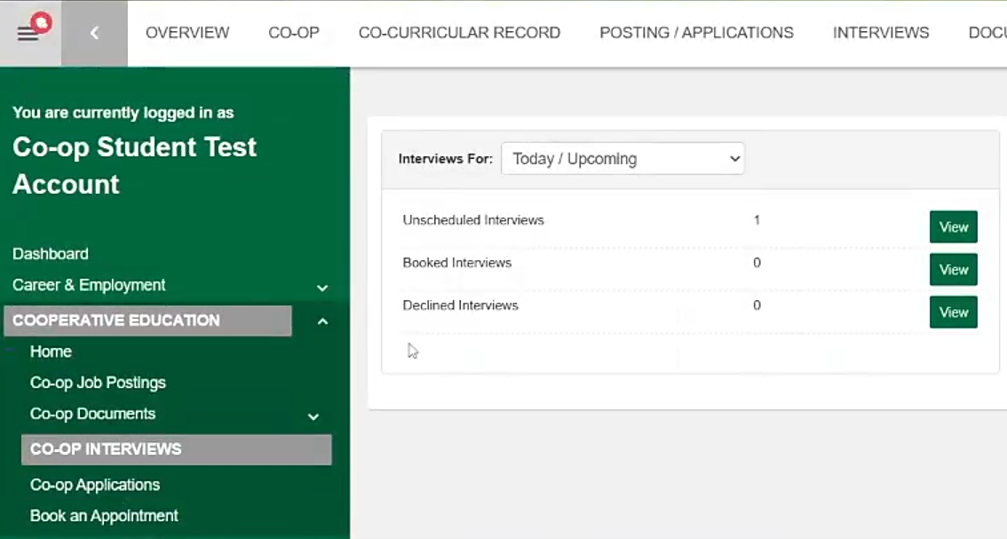
Co-op Interviews Page in HireAC
Log into HireAC, Cooperative Education Module
Go to the Co-op Interviews page to view your interview record. Use the drop-down menu at the top of the page to filter your records by time frame.
Unscheduled Interviews – View and respond to current interview invitations.
Booked Interviews – Review details of your upcoming or completed interviews.
Declined Interviews – Access the invitations you declined.

Slide 6
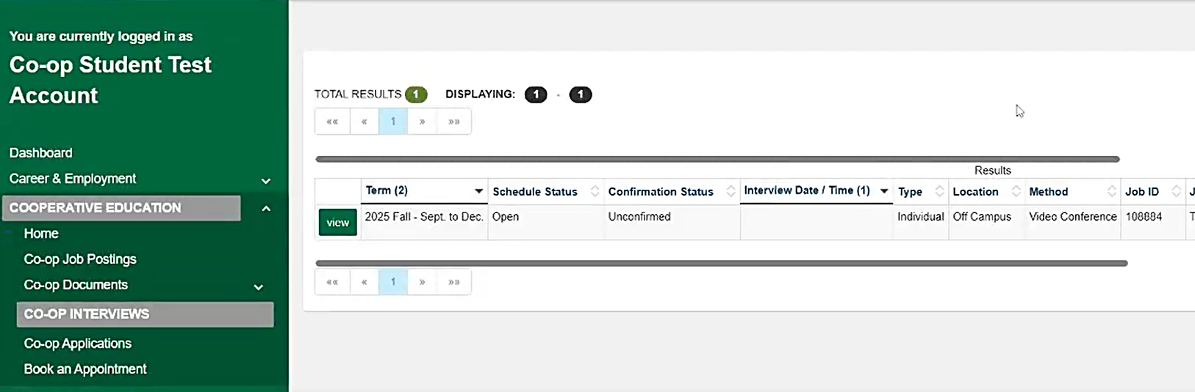
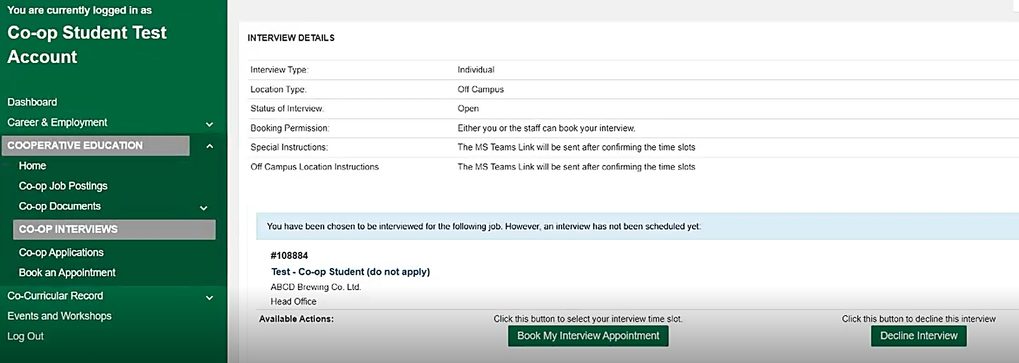
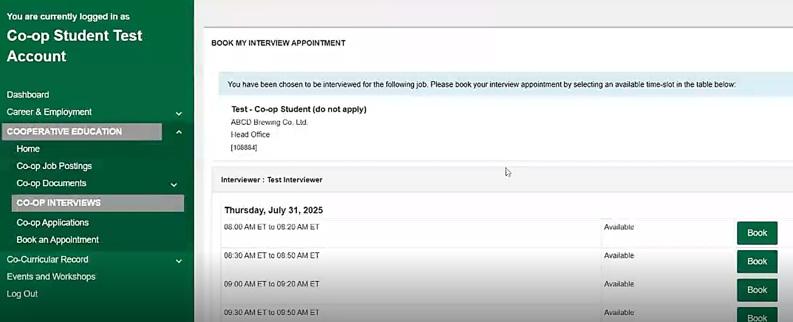
Confirming the interview and booking a time slot
To respond to an interview invitation, click View on the right-hand side of the invitation.
You will be redirected to a new page displaying additional interview details.
To accept the invitation, click Book my Interview Appointment. On the next page, you will be able to review and select an available time slot.
To decline the invitation, click Decline Interview.
1
2
4
3

Slide 7
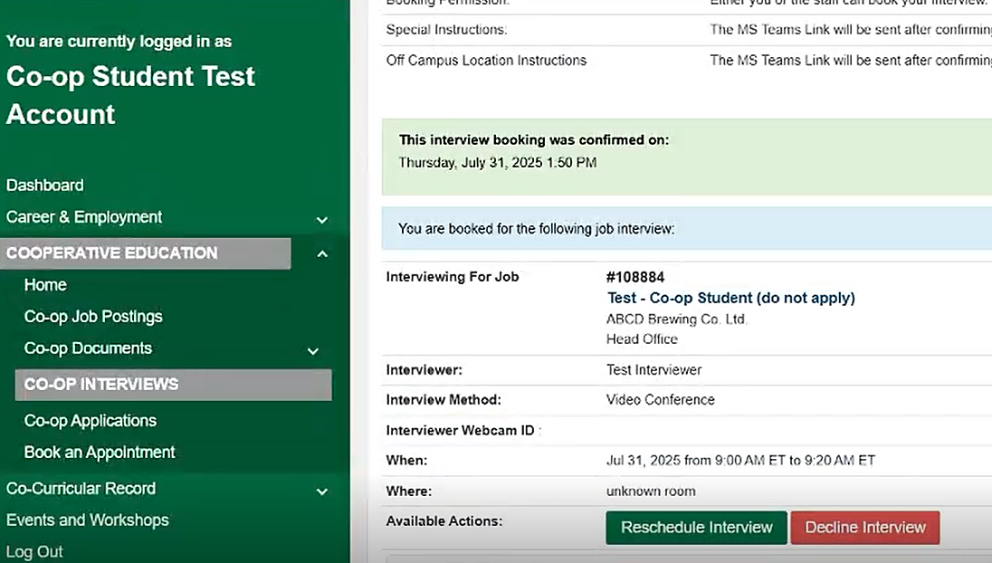
View Booked Interview Details
View the details of your booked interviews in the Booked Interviews record.
Interview details include:
Job tile, link to the job description, company name
Date, time and location
Interviewer name(s)
Interview method: on campus, off campus, video conference
Special instructions and off campus location instructions
Refer to the Special Instructions for information on how the virtual interview link will be shared

